Slide 1


UNILEVER CANTEEN ORDERING OPTIMISATION
July 2024
Presentation By:
Team Business Builders

Slide 2




If you are a happy man, then you can give your best...
Ronald Koeman
No man can be wise on an empty stomach...
George Eliot

Slide 3

ABOUT THE COMPANY
Unilever is a British-Dutch multinational fast-moving consumer goods (FMCG) company headquartered in London, England. With a rich history spanning over a century, Unilever stands as one of the oldest and most renowned FMCG companies in the world. Being a global company with a global purpose, Unilever is committed to making sustainable living commonplace.
Operating in over 190 countries and employing 128,000 people, Unilever is dedicated to improving the lives of consumers through a diverse range of products. The company’s portfolio includes some of the world’s most beloved brands, providing trusted products in nutrition, hygiene, and personal care to millions of households daily.

Slide 4

PROBLEM STATEMENT
The current ordering process in the Unilever canteens is inefficient as a result of;
Lack of capacity to effectively accommodate the volume of customers who prefer to eat their launch between 12 and 1pm, leading to long waiting time for meals and tables
Poor and inaccurate order planning that results in a high level of wastage, while not being able to meet demand.
Lack of a delivery option that will allow employees to have their meals brought to them at their work station, rather than going to the canteen for their meals.
Notes:
Include point on customer dissatisfaction,

Slide 5

OBJECTIVES
The objectives of the new Canteen Ordering System are;
To reduce the lunchtime of employees by 60% by eliminating waiting time for meals through advance ordering online
To eliminate the commute of employees to and from the canteen by having meals delivered to the workstation of employees.
To eliminate wastage and ensure availability of meals requested via advance order being sent to the Chef
To integrate the employee’s meal payment with their payroll administration
Notes:
We need to include a quantification of the wastage to be eliminated. 90% may be a good amount Also include an objective that captures the diversion of the time saving to work hours Rephrase Objective 1

Slide 6

STAKEHOLDERS
Employees (Customers)
Executive Management
Chef
Menu Manager
Canteen Manager (Order Processor)
Meal Deliverer
Finance (Payroll Manager)
Canteen Staff
Developer
Project Manager
IT Manager
System Administrator
Suppliers
Tester
Trainer
HR Manager
Helpdesk

Slide 7
STAKEHOLDER ANALYSIS
Name | Title | Role | Interest | Power
Olabisi Sarah | Executive Director
Omolara Mary | Manager Human Resource | Project Sponsor | High | High
Oluwaseun Susan | Project Manager | Project Manager | High | High
Yvonne Morfaw | Business Analyst | Business Analyst | High | High
Seun John | Manager Staff Welfare | SME | High | High
Uren Bonita | Pay Roll Manager | SME | High | Low
Tatenda May | Chief Technology Officer | SME | Low | High
Emem Irene | Canteen Manager | SME | High | Low
Chinyeru Pam | Compliance Manager | SME | High | Low
Elora Kizita | Developer | Developers | High | Low
John Wall | Testers | Tester | High | Low
Angela Wike | System Admin | System Admin | High | Low
Pamela Mann | Menu Manager | User | High | Low
Stacy Matthew | Chief Cook | User | High | Low
Staff | Users | User | High | Low
Doreen Aduke | Delivery Team | User | High | Low
Notes:
Yyvonne please make sure everyones name is included

Slide 8
STAKEHOLDER MATRIX
HIGH
Keep Satisfied | Manage Closely
Finance | Executive Management PM HR
Monitor | Keep Informed
Suppliers Helpdesk | Meal Deliverer Canteen Staff Employee Chef Menu Manager Developer Tester Trainer
Power
LOW
Interest
HIGH
Notes:
Update the matrix to align with stakeholder analysis table

Slide 9


BUSINESS CASE

Slide 10

MEET STEVE
Steve works in the IT department, and has been working since 8AM to meet a deadline. He has been on the task for three days and today is the last day.
He has barely eaten a good meal in the last 24 hours, working night and day to meet this deadline. He is famished, on his desk, and his only hope of a quick proper meal is the Canteen.
He thinks of the stress, the queue, and the time it will take to get a meal from the canteen, and he gives up hope, just to save time to push through the deadline, and make a presentation on the project that same evening.
He is helpless in the face of inefficiency in the Canteen, which could have saved the day for him.

Slide 11


BUSINESS CASE CONT’D...
Problem Statement
Objectives
To reduce the time spent on lunch breaks by 75% by eliminating waiting times through advance online ordering.
To improve order accuracy and reduce food waste by ensuring meals prepared are meals demanded.
To enable delivery of meals to employees to their workstations, eliminating the need to commute to the canteen.
To simplify the payment process for meals by integrating meal payments with the payroll system for automatic salary deductions.
The current canteen process is inefficient due to long wait times, lack of meal availability, and significant food waste.
Employees spend considerable time away from their workstations, which reduces productivity.
There is also no mechanism for employees to order meals in advance or have them delivered to their desks.
Notes:
Please adjust according to amendments in prior slides on Problem Statement and objectives

Slide 12




SOLUTION OPTIONS
Build additional 4 canteens to cater to the number of employees
Automate the canteen order process so employees can order what they want and eat at their work stations
Close all existing canteens on the building so employees can sort themselves.

Slide 13
PROPOSED SOLUTION ANALYSIS
Building additional canteens
Automate canteen order process
Close all canteens
System automation is more cost effective and aligns with the company’s growth plan. It also eliminates all the problems identified with the current system and increase employee performance.
This solution will go along way to address some challenges faced with the current system. It is however not cost effective in the long run as the company continues to expand.
This option may only make the existing system worse as employees will have to go sort lunch externally. This can lead to extended lunch breaks and decline in performance
Notes:
It will be good to have a decision matrix along with this

Slide 14

RECOMMENDED SOLUTION
Automated canteen order system which integrates seemlessly with the company’s existing HR and Payroll systems

Slide 15
COST-BENEFIT ANALYSIS
BENEFITS
COST
Improved order system efficiency
Improved employee satisfaction
Time saving for employees and canteen staff
Significant reduction in food waste
Improved canteen menu as it will be data driven
Initial implementation cost to develop the software £60,000 - 90,000 and integration of existing HR and Payroll systems.
Recurrent periodic maintenance cost 10% of the initial cost annually

Slide 16
RISK ANALYSIS & MITIGATION
Risk | Mitigation
Accuracy | Constantly testing and retesting of algorithm to ensure accuracy
Resistance to change by employees | Proper training of the employees and stating the benefits involve in transition to automation method of operation
Software breakdown | Employment of competent software developer that will constantly test the app functionality
COST
Notes:
Please see if we can add more risks and mitigation Include a conclusion statement for the business case (1 Slide)

Slide 17
RACI MATRIX

Slide 18
RACI MATRIX
 | Business Analyst | Project Manager | Subject Matter Expert | Developer | Tester | System Administrator | Trainer | User
Define problem | R | A | C |  |  |  |  | C
Elicit requirements | R | A | C |  |  |  |  | C
Design new canteen order process | R | A | C |  |  |  |  | C, I
Build new canteen order process | C | A |  | R |  | I
Test new canteen order process | C,A | A |  |  | R | I |  | R
Deploy new canteen order process | I | A |  |  |  | R | I | I
Train all participants involved (users) | C,A | A | C |  |  | I | R | C, I
Notes:
Please look at this again to see if any improvement can be made

Slide 19
WEB APP FEATURES

Slide 20
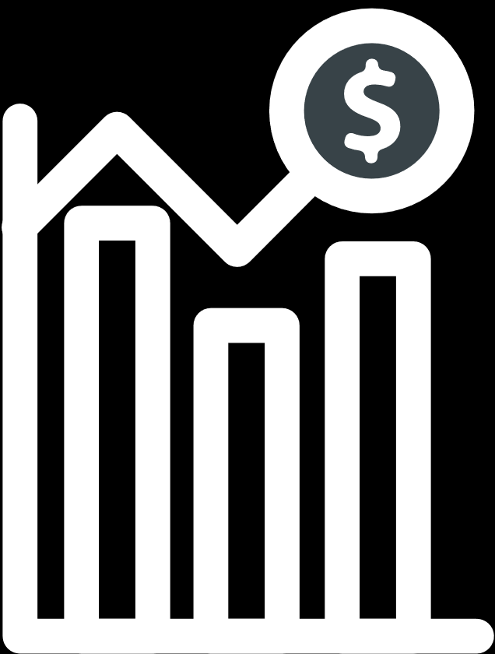
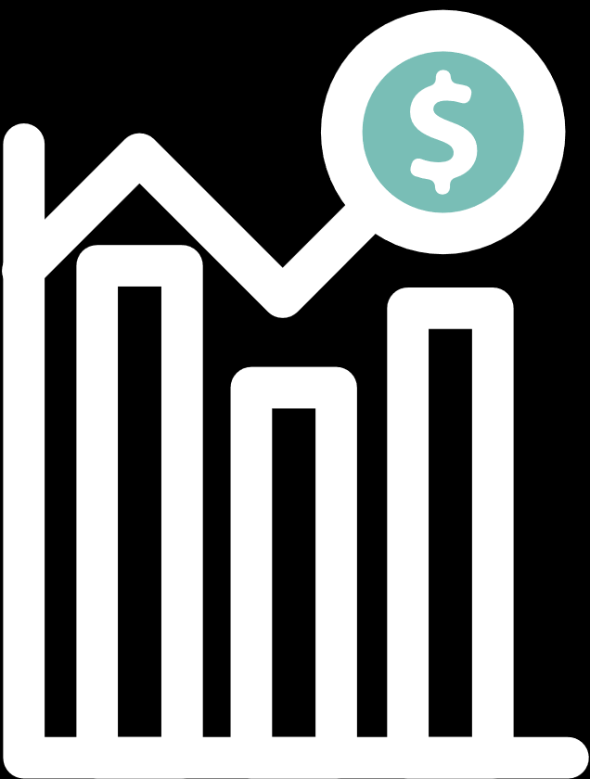
MAIN
FEATURES
User Interfaces
Menu View
Employees, Kitchen Staff, Delivery Staff, Payroll
Showing Real-Time menu options
Meal Selection
Order Placement
Order Status

Slide 21
MAIN
FEATURES
Order Tracking
Order History
Meal Delivery
Payroll Integration

Slide 22
PROCESS MAP

Slide 23
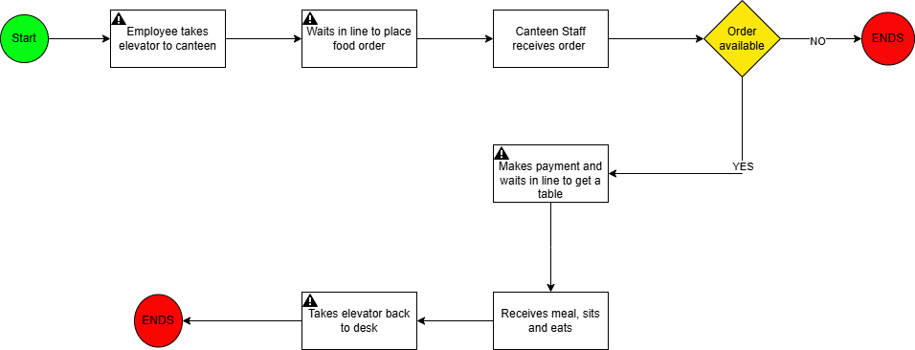
AS-IS PROCESS....

Slide 24
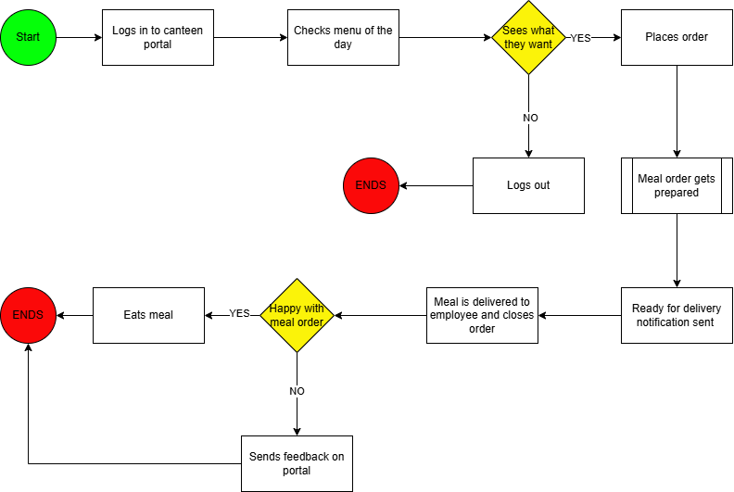
TO-BE PROCESS....
Notes:
Please check with Tersoo and the recordings to see if we can improve this

Slide 25
USER STORIES

Slide 26
User Stories
 | User Stories
User Interfaces | As an employee, I want to log in with my credentials so that I can access the canteen ordering system. As an employee, I want to provide feedback on meals and delivery service so that the canteen can improve its services. As a kitchen staff member, I want to log in with my credentials so that I can manage meal preparation tasks. As a kitchen staff member, I want to view all incoming orders clearly so that I can prepare meals efficiently. As a delivery staff member, I want to log in with my credentials so that I can see my delivery assignments. As a delivery staff member, I want to update the status of each delivery so that employees are informed about their meal delivery. As a payroll manager, I want to log in with my credentials so that I can manage meal payment deductions. As a payroll manager, I want to view order histories and generate reports so that payroll deductions are accurate and verified.

Slide 27
User Stories
 | User Stories
Menu View | As an employee, I want to view the real-time menu with available dishes and prices so that I can choose my meal options. As a menu manager, I want to update the daily menu so that employees see the most current options. As an employee, I want to filter menu options by category, price, or dietary preferences so that I can find suitable meals.
Meal Selection | As an employee, I want to select multiple dishes from the daily menu so that I can customize my lunch order. As an employee, I want to edit my meal selection before finalizing the order so that I can change my choices if needed. As an employee, I want to see a summary of my selected dishes with their total price so that I know the cost before placing the order. As an employee, I want to save my favorite meal combinations so that I can reorder them easily in the future.

Slide 28
User Stories
 | User Stories
Order Placement | As an employee, I want to place my meal order before 11 am so that my lunch is prepared and delivered on time. As a kitchen staff member, I want to receive before 11 am so that I have enough time to prepare the meals. As an employee, I want to receive a confirmation of my order with a summary so that I know my order has been placed. As an employee, I do not want to be able to cancel or edit my order after confirmation so that the kitchen staff can prepare meals accurately.
Order Status | As an employee, I want to check the real-time status of my order so that I know when to expect my meal. As a kitchen staff member, I want to update the order status as it progresses so that employees are informed about their meal preparation. As an employee, I want to be notified when my meal is ready for delivery and when it has been delivered so that I can plan accordingly.

Slide 29
User Stories
 | User Stories
Meal Delivery | As a delivery staff member, I want to see the details of each delivery, including destination and employee information, so that I can deliver meals accurately. As a delivery staff member, I want to update the status of each delivery in real-time so that employees are informed about their meal delivery. As an employee, I want my meal delivered to my workstation so that I do not have to leave my desk during lunch.
Payroll Integration | As an employee, I want to enroll for salary payment deduction so that my meal payments are handled automatically. As an employee, I want the system to calculate the total amount to be deducted based on my orders so that I do not have to manage separate payments. As a payroll manager, I want the system to integrate with the payroll system so that meal payments are deducted automatically. As a payroll manager, I want to generate monthly reports of meal deductions so that I can ensure accurate payroll processing. As a payroll manager, I want to be able to verify amounts deductable for meals from employee’s salary in order to ensure accuracy of deductions.

Slide 30
User Stories
 | User Stories
Order Tracking | As an employee, I want to track the delivery of my meal in real-time so that I know when it will arrive at my workstation. As a delivery staff member, I want to update the delivery status in real-time so that employees are informed about the progress. As an employee, I want to receive notification of my meal delivery time.
Order History | As an employee, I want to view my past orders so that I can reorder my favorite meals easily. As an employee, I want to see details of my past orders, including date, time, and meal details, so that I can keep track of what I’ve ordered. As a payroll manager, I want to access order history for all employees so that I can verify payment deductions. As a payroll manager, I want to generate monthly reports of meal deductions so that payroll processing is accurate.

Slide 31
JIRA BACKLOG

Slide 32
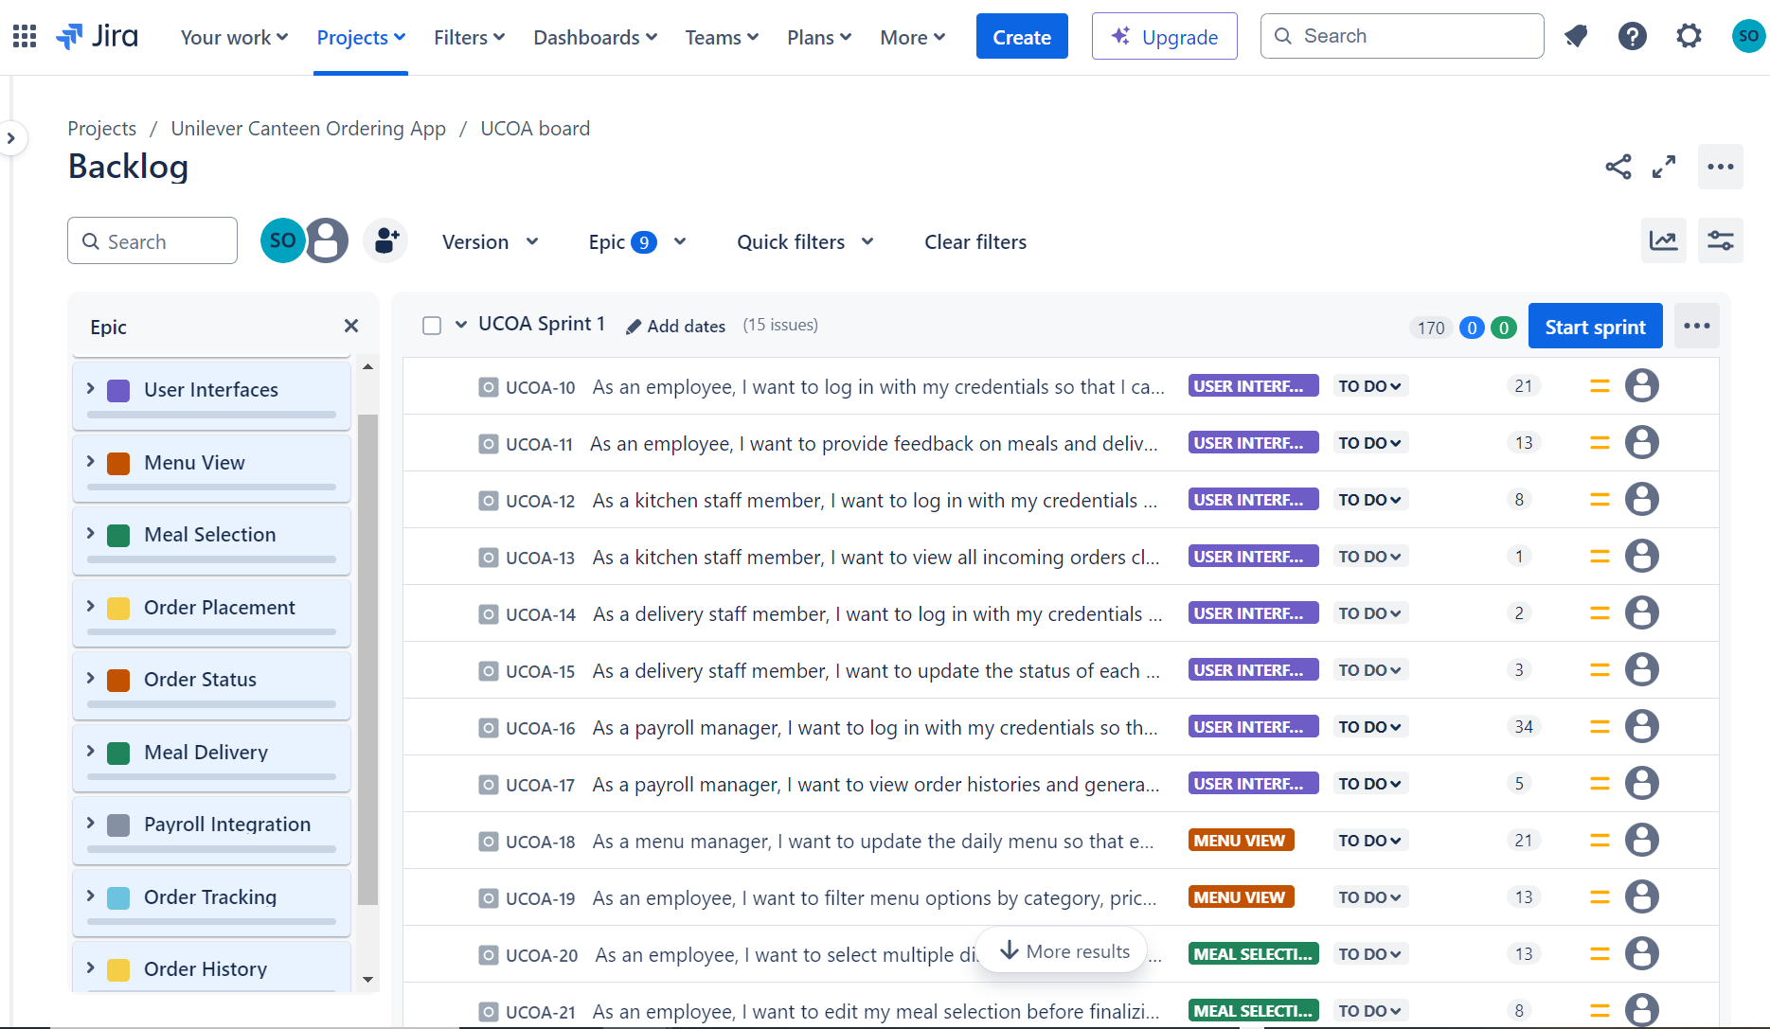
Sprint 1 Backlog

Slide 33
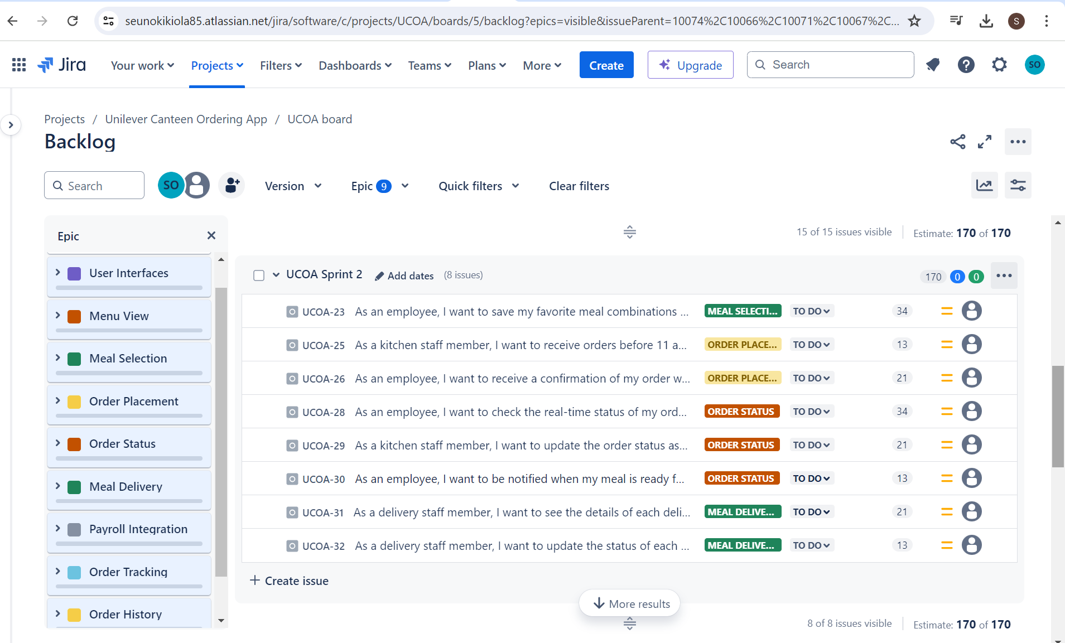
Sprint 2 Backlog

Slide 34
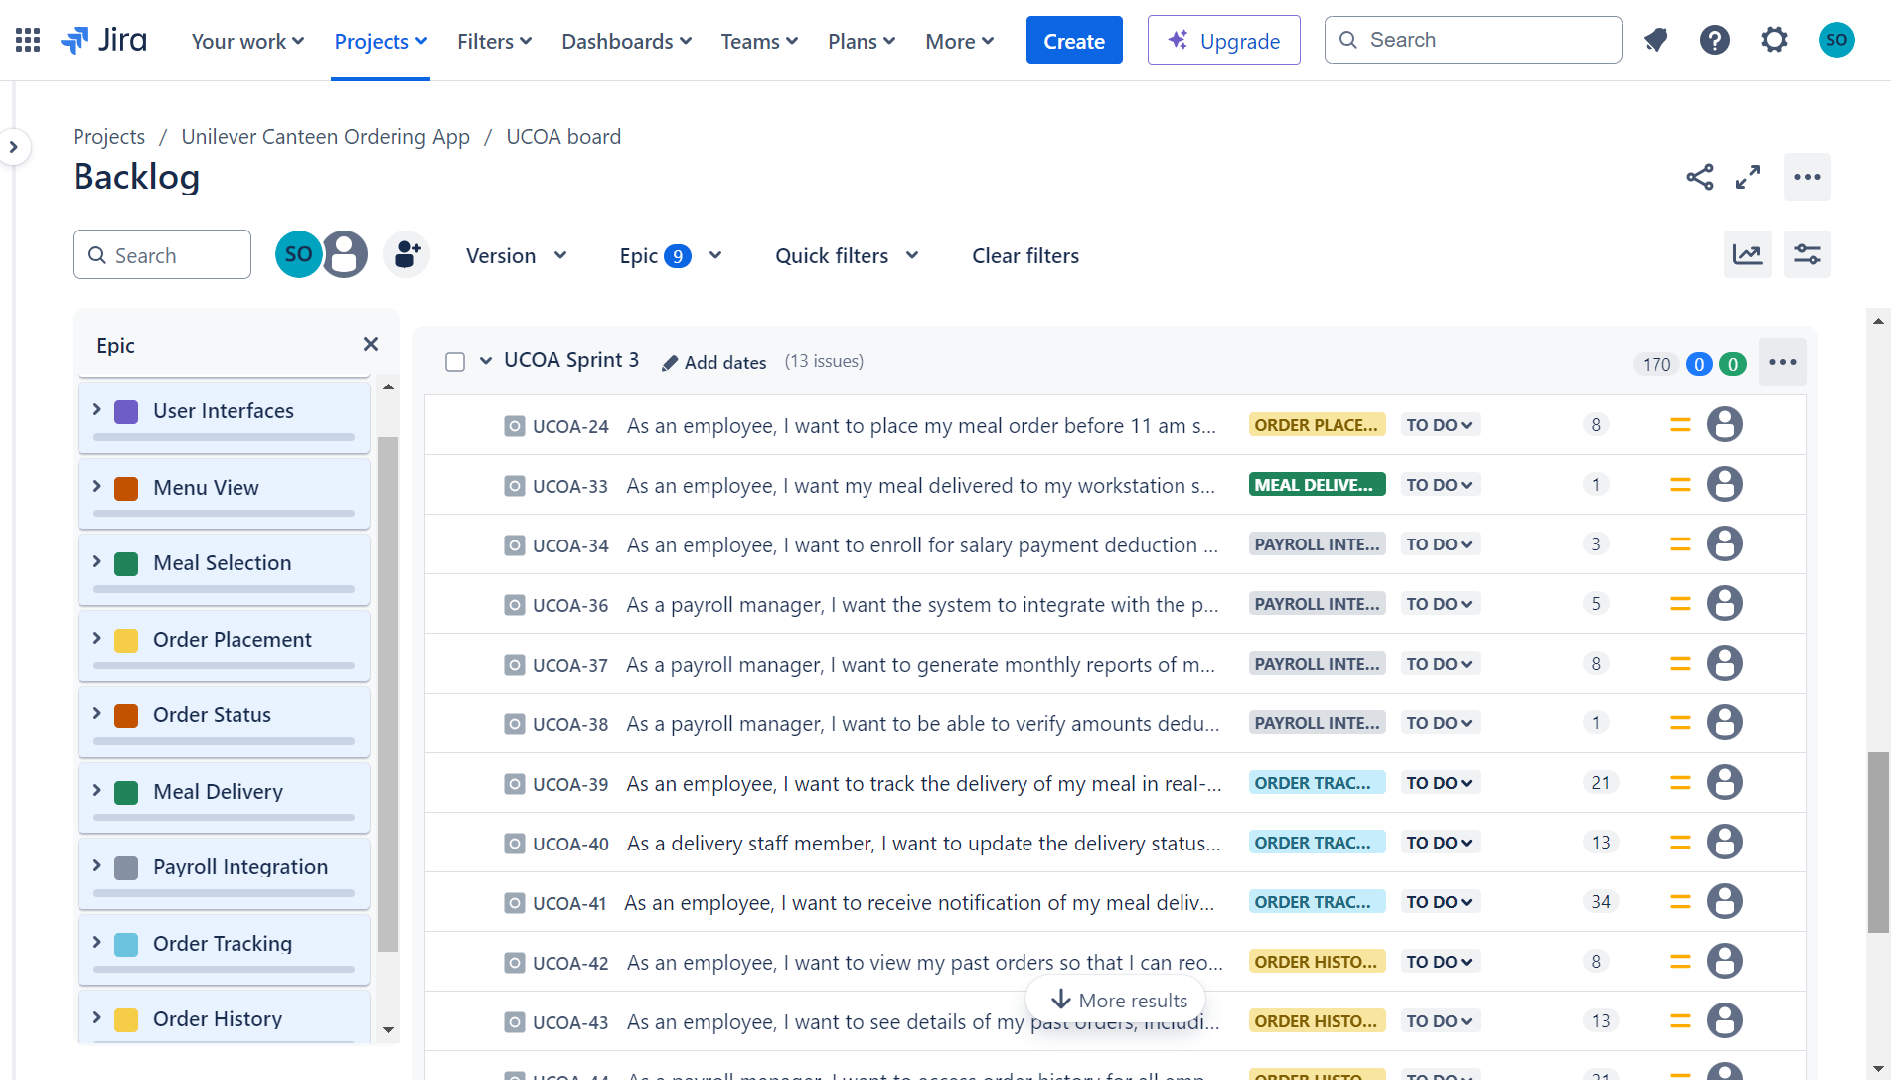
Sprint 3 Backlog

Slide 35
Thank You

